Slide 1
Sobolev(+Node 6, 7) Showcase
+K20m GPU Accelerator

Slide 3
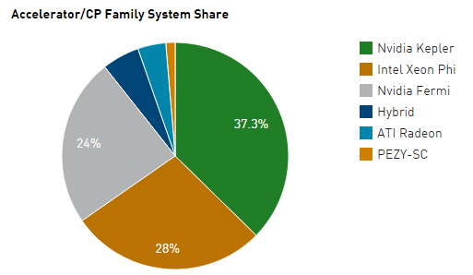
Supercomputer
www.top500.org
The No. 1, Tianhe-2, and the No. 7, Stampede.
-Intel Xeon Phi processors
The No. 2, Titan, and the No. 6, Piz Daint.
-NVIDIA GPUs
Share
GPU : NVIDIA 46, ATI Radeon 3
Xeon Phi : 21
Hybrid : 4

Slide 4
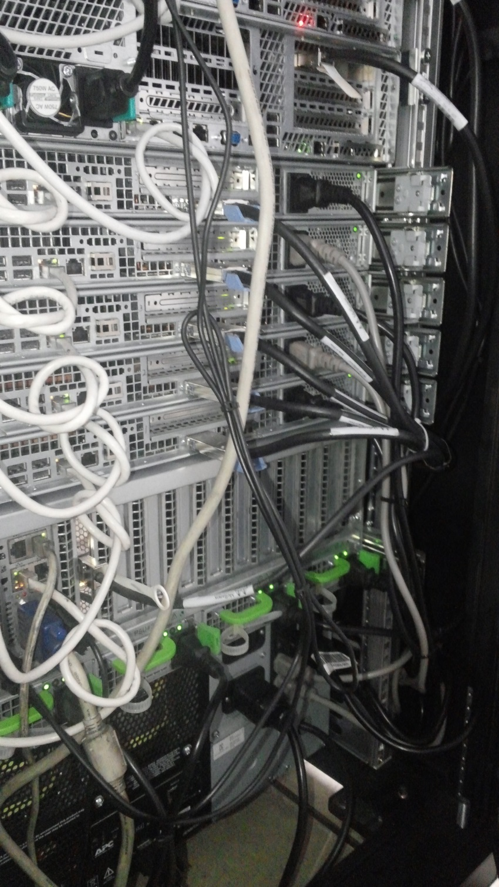

Slide 5
Hardware Specification
Main module
4 * Intel Xeon X7550 : 2GHz, 18MB Cache, 8Cores
Memory : 64GB
QDR 40Gb/s Infiniband
Sub-module (*5)
2 * Intel Xeon X5660 : 2.8GHz, 12MB Cache, 6Cores
Memory : 48GB
QDR 40Gb/s Infiniband
Sub-module (*2)
2 * Intel Xeon E5-2650 : 2.6GHz, 20MB Cache, 8Cores
Memory : 128GB
QDR 40Gb/s Infiniband

Slide 6
Monitoring : sobolev.kaist.ac.kr
Sobolev
Node1
Node6
GPU
Node2
Node7
GPU
Node3
Node4
Node5

Slide 7
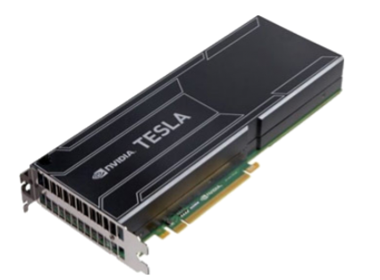
Tesla K20m
CUDA parallel processing cores : 2496
Memory size : 5GB GDDR5
Processor core clock : 706 MHz
Peak double precision floating point performance : 1.17Tflops
Thermal solution : Passive

Slide 8
Test problem
$$\text{−}\text{∆}u=f in Ω=\left[0,1\right]×[0,1]$$
$$u=0 on ∂Ω$$
Solution : $u=\sin^{2}(πx)$ $\cos^{2}(πx)$
Jacobi (GPU) vs Block Jacobi (CPU)
Conjugate gradient method

Slide 9
1.Jacobi (GPU) vs Block Jacobi (CPU)
Meshsize(h) | Jacobi | Block Jacobi
 | CUDA(GPU) | mpi3*3(CPU) | mpi6*6(CPU) | mpi9*9(CPU)
1/128 | 0.49 | 0.6630 | 0.3285 | 1.3400
1/256 | 4.06 | 20.1053 | 4.8383 | 3.0964
1/512 | 47.3 | 273.5613 | 103.8234 | 54.2547
1/1024 | 938.85 | 4297.2409 | 1438.0965 | 741.5949

Slide 10
1.Jacobi (GPU) vs Block Jacobi (CPU)

Slide 11
2.Conjugate Gradient
 | CUDA | mpi1 | mpi2 | mpi4 | mpi8 | mpi16 | mpi32 | mpi64
1/256 | 0.11 | 1.17 | 0.59 | 0.31 | 0.17 | 0.12 | 0.13 | 0.23
1/512 | 0.4 | 8.90 | 4.46 | 2.26 | 1.19 | 0.69 | 0.45 | 0.51
1/1024 | 2.23 | 79.37 | 38.58 | 20.35 | 11.31 | 5.74 | 2.89 | 2.11
1/2048 | 15 | 649.91 | 320.47 | 178.33 | 114.00 | 69.20 | 30.68 | 15.42

Slide 12
2.Conjugate Gradient

